Slide 1
Network Layer Part II: Routing

Slide 2
Questions
How does the router build the routing table?
How do you control the over all operation of the network layer?
Getting IP addresses: DHCP
Routing: OSPF, BGP, RIP
Network Management: SNMP
Errors: ICMP

Slide 3
Interplay between routing, forwarding
Q: How does the router compute the routing table?
Collect information about the network
Use this information as input to a routing algorithm
These are all slow processes (in msec scale)
Can be done in software
Remember:
Address lookup and forwarding is done for every packet
nanosecond scale operation
done in hardware

Slide 4
Fundamentals for routing table computation: Graph abstraction
5
v
3
w
2
5
u
2
1
z
3
1
2
x
y
1
Graph: G = (N,E)
N = set of routers = { u, v, w, x, y, z }
E = set of links ={ (u,v), (u,x), (v,x), (u,w), (v,w),
(x,w), (x,y), (w,y), (w,z), (y,z) }

Slide 5
Fundamentals for routing table computation: Graph abstraction costs
5
c(p,q) = cost of link (p,q)
- e.g., c(w,z) = 5
cost could always be 1, or
inversely related to bandwidth,
or inversely related to
congestion
v
3
w
2
5
u
2
1
z
3
1
2
x
y
1
Cost of path (x₁, x₂, x₃,…, x_{p}) = c(x₁,x₂) + c(x₂,x₃) + … + c(x_{p-1},x_{p})
Question: What’s the least-cost path between u and z ?
Routing algorithm: algorithm that finds least-cost path

Slide 6
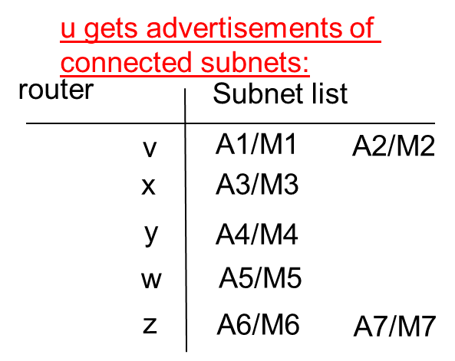
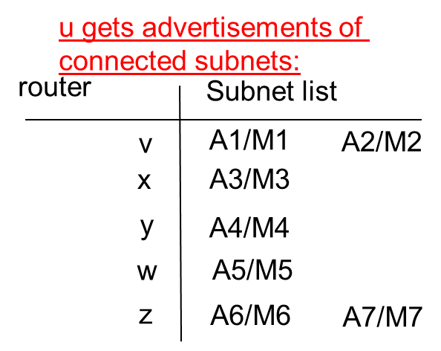
Routing
5
3
A/M: Address/Subnet Mask pair
v
w
2
5
u
2
1
z
3
1
2
x
y
1
Task of u:
Find the least cost path to all routers (all subnets)
Determine Outgoing interface of u on the least cost path to all subnets
ALL ROUTERS DO THE SAME SUCH THAT ALL PACKETS FOLLOW THE LEAST COST PATHS TO THEIR DESTINATIONS

Slide 7
Routing Algorithm classification
Global or decentralized information?
Global:
all routers have complete topology, link cost info
“link state” algorithms
Decentralized:
router knows physically-connected neighbors, link costs to neighbors
iterative process of computation, exchange of info with neighbors
“distance vector” algorithms
Static or dynamic?
Static:
routes change slowly over time
Dynamic:
routes change more quickly
periodic update
in response to link cost changes

Slide 8
A Link-State Routing Algorithm
Dijkstra’s algorithm
net topology, link costs known to all nodes
accomplished via “link state broadcast”
all nodes have same info
computes least cost paths from one node (‘source”) to all other nodes
gives forwarding table for that node
iterative: after k iterations, know least cost path to k dest.’s

Slide 9
Dijsktra’s Algorithm (for node u)
Notation:
c(x,y): link cost from node x to y; = ∞ if not direct neighbors
D(r): current value of cost of path from source to dest. r
p(r): predecessor node along path from source to r
N': set of nodes whose least cost path definitively known
1 Initialization:
2 N' = {u}
3 for all nodes r
4 if r adjacent to u
5 then D(r) = c(u,r)
6 else D(r) = ∞
7
8 Loop
9 find q not in N' such that D(q) is a minimum
10 add q to N'
11 update D(r) for all r adjacent to q and not in N' :
12 D(r) = min( D(r), D(q) + c(q,r) )
13 /* new cost to r is either old cost to r or known
14 shortest path cost to q plus cost from q to r */
15 until all nodes in N'

Slide 10
Dijkstra’s algorithm: example
Step
0
N'
u
D(v),p(v)
2,u
D(w),p(w)
5,u
D(x),p(x)
1,u
D(y),p(y)
∞
D(z),p(z)
∞
Initialization:
N' = {u}
for all nodes r
if r adjacent to u
then D(r) = c(u,r)
else D(r) = ∞
Notation:
N': set of nodes whose least cost path definitively known
c(x,y): link cost from node x to y; = ∞ if not direct neighbors
D(r): current value of cost of path from source to dest. r
p(r): predecessor node along path from source to r
5
v
3
w
2
5
u
2
1
z
3
1
2
x
y
1

Slide 11
Dijkstra’s algorithm: example
Step
0
1
N'
u
u, x
D(v),p(v)
2,u
2,u
D(w),p(w)
5,u
4,x
D(x),p(x)
1,u
D(y),p(y)
∞
2,x
D(z),p(z)
∞
∞
find q not in N' such that D(q) is a minimum
add q to N'
update D(r) for all r adjacent to q and not in N' :
D(r) = min( D(r), D(q) + c(q,r) )
until all nodes in N'
5
v
3
w
2
5
u
2
1
z
3
1
2
x
y
1

Slide 12
Dijkstra’s algorithm: example
Step
0
1
2
N'
u
u, x
u, x, y
D(v),p(v)
2,u
2,u
2,u
D(w),p(w)
5,u
4,x
3,y
D(x),p(x)
1,u
D(y),p(y)
∞
2,x
D(z),p(z)
∞
∞
4,y
find q not in N' such that D(q) is a minimum
add q to N'
update D(r) for all r adjacent to q and not in N' :
D(r) = min( D(r), D(q) + c(q,r) )
until all nodes in N'
5
v
3
w
2
5
u
2
1
z
3
1
2
x
y
1

Slide 13
Dijkstra’s algorithm: example
Step
0
1
2
3
N'
u
u, x
u, x, y
u, x, y, v
D(v),p(v)
2,u
2,u
2,u
D(w),p(w)
5,u
4,x
3,y
3,y
D(x),p(x)
1,u
D(y),p(y)
∞
2,x
D(z),p(z)
∞
∞
4,y
4,y
find q not in N' such that D(q) is a minimum
add q to N'
update D(r) for all r adjacent to q and not in N' :
D(r) = min( D(r), D(q) + c(q,r) )
until all nodes in N'
5
v
3
w
2
5
u
2
1
z
3
1
2
x
y
1

Slide 14
Dijkstra’s algorithm: example
Step
0
1
2
3
4
N'
u
u, x
u, x, y
u, x, y, v
u, x, y, v, w
D(v),p(v)
2,u
2,u
2,u
D(w),p(w)
5,u
4,x
3,y
3,y
D(x),p(x)
1,u
D(y),p(y)
∞
2,x
D(z),p(z)
∞
∞
4,y
4,y
4,y
find q not in N' such that D(q) is a minimum
add q to N'
update D(r) for all r adjacent to q and not in N' :
D(r) = min( D(r), D(q) + c(q,r) )
until all nodes in N'
5
v
3
w
2
5
u
2
1
z
3
1
2
x
y
1

Slide 15
Dijkstra’s algorithm: example
Step
0
1
2
3
4
5
N'
u
u, x
u, x, y
u, x, y, v
u, x, y, v, w
u, x, y, v, w, z
D(v),p(v)
2,u
2,u
2,u
D(w),p(w)
5,u
4,x
3,y
3,y
D(x),p(x)
1,u
D(y),p(y)
∞
2,x
D(z),p(z)
∞
∞
4,y
4,y
4,y
find q not in N' such that D(q) is a minimum
add q to N'
update D(r) for all r adjacent to q and not in N' :
D(r) = min( D(r), D(q) + c(q,r) )
until all nodes in N'
5
v
3
w
2
5
u
2
1
z
3
1
2
x
y
1

Slide 16
Dijkstra’s algorithm: example
Resulting shortest-path tree from u:
v
w
Resulting forwarding table in u:
2
u
z
destination
link
total cost
1
1
v
(u,v)
2
x
y
2
x
(u,x)
1
1
y
(u,x)
2
Resulting forwarding table in u:
(u,x)
w
3
destination
Link (interface)
z
(u,x)
4
A1/M1
(u,v)
A2/M2
(u,v)
A3/M3
(u,x)
A4/M4
(u,y)
A5/M5
(u,w)
A6/M6
(u,z)
A6/M7
(u,z)

Slide 17
Dijkstra’s algorithm, discussion
Algorithm complexity: n nodes
each iteration: need to check all nodes, q, not in N’
n(n-1)/2 comparisons: O(n²)
more efficient implementations possible: O(nlogn)
Oscillations possible:
e.g., link cost = amount of carried traffic
Prefer low cost links➔ increase the amount of traffic➔ increase the link cost ➔ now low cost links are different ➔route has to be recomputed

Slide 18
A Distance Vector Algorithm
Bellman-Ford’s algorithm
Each node receives information only from its directly connected neighbors
Iterative: Stops when there is no more information to exchange
The nodes do not have to compute at the same time (asynchronous)

Slide 19
Comparison of LS and DV algorithms
Message complexity
LS: with n nodes, E links, O(nE) msgs sent
DV: exchange between neighbors only
convergence time varies
Speed of Convergence
LS: O(n²) algorithm requires O(nE) msgs
may have oscillations
DV: convergence time varies
may be routing loops
count-to-infinity problem
Robustness: what happens if router malfunctions?
LS:
node can advertise incorrect link cost
each node computes only its own table
DV:
DV node can advertise incorrect path cost
each node’s table used by others
error propagates through the network

Slide 20

Hierarchical Routing
administrative autonomy
internet = network of networks
each network admin may want to control routing in its own network

Slide 21
Hierarchical Routing
aggregate routers into regions, “autonomous systems” (AS)
An AS is a connected group of one or more IP prefixes run by one or more network operators which has a SINGLE and CLEARLY DEFINED routing policy.
routers in same AS run same routing protocol
“intra-AS” routing protocol
routers in different AS can run different intra-AS routing protocol
Border Gateway router
Direct link to router in another AS

Slide 22
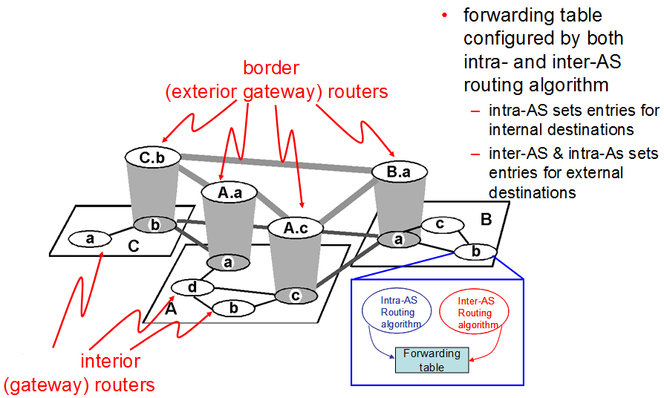
Internet AS Hierarchy

Slide 23
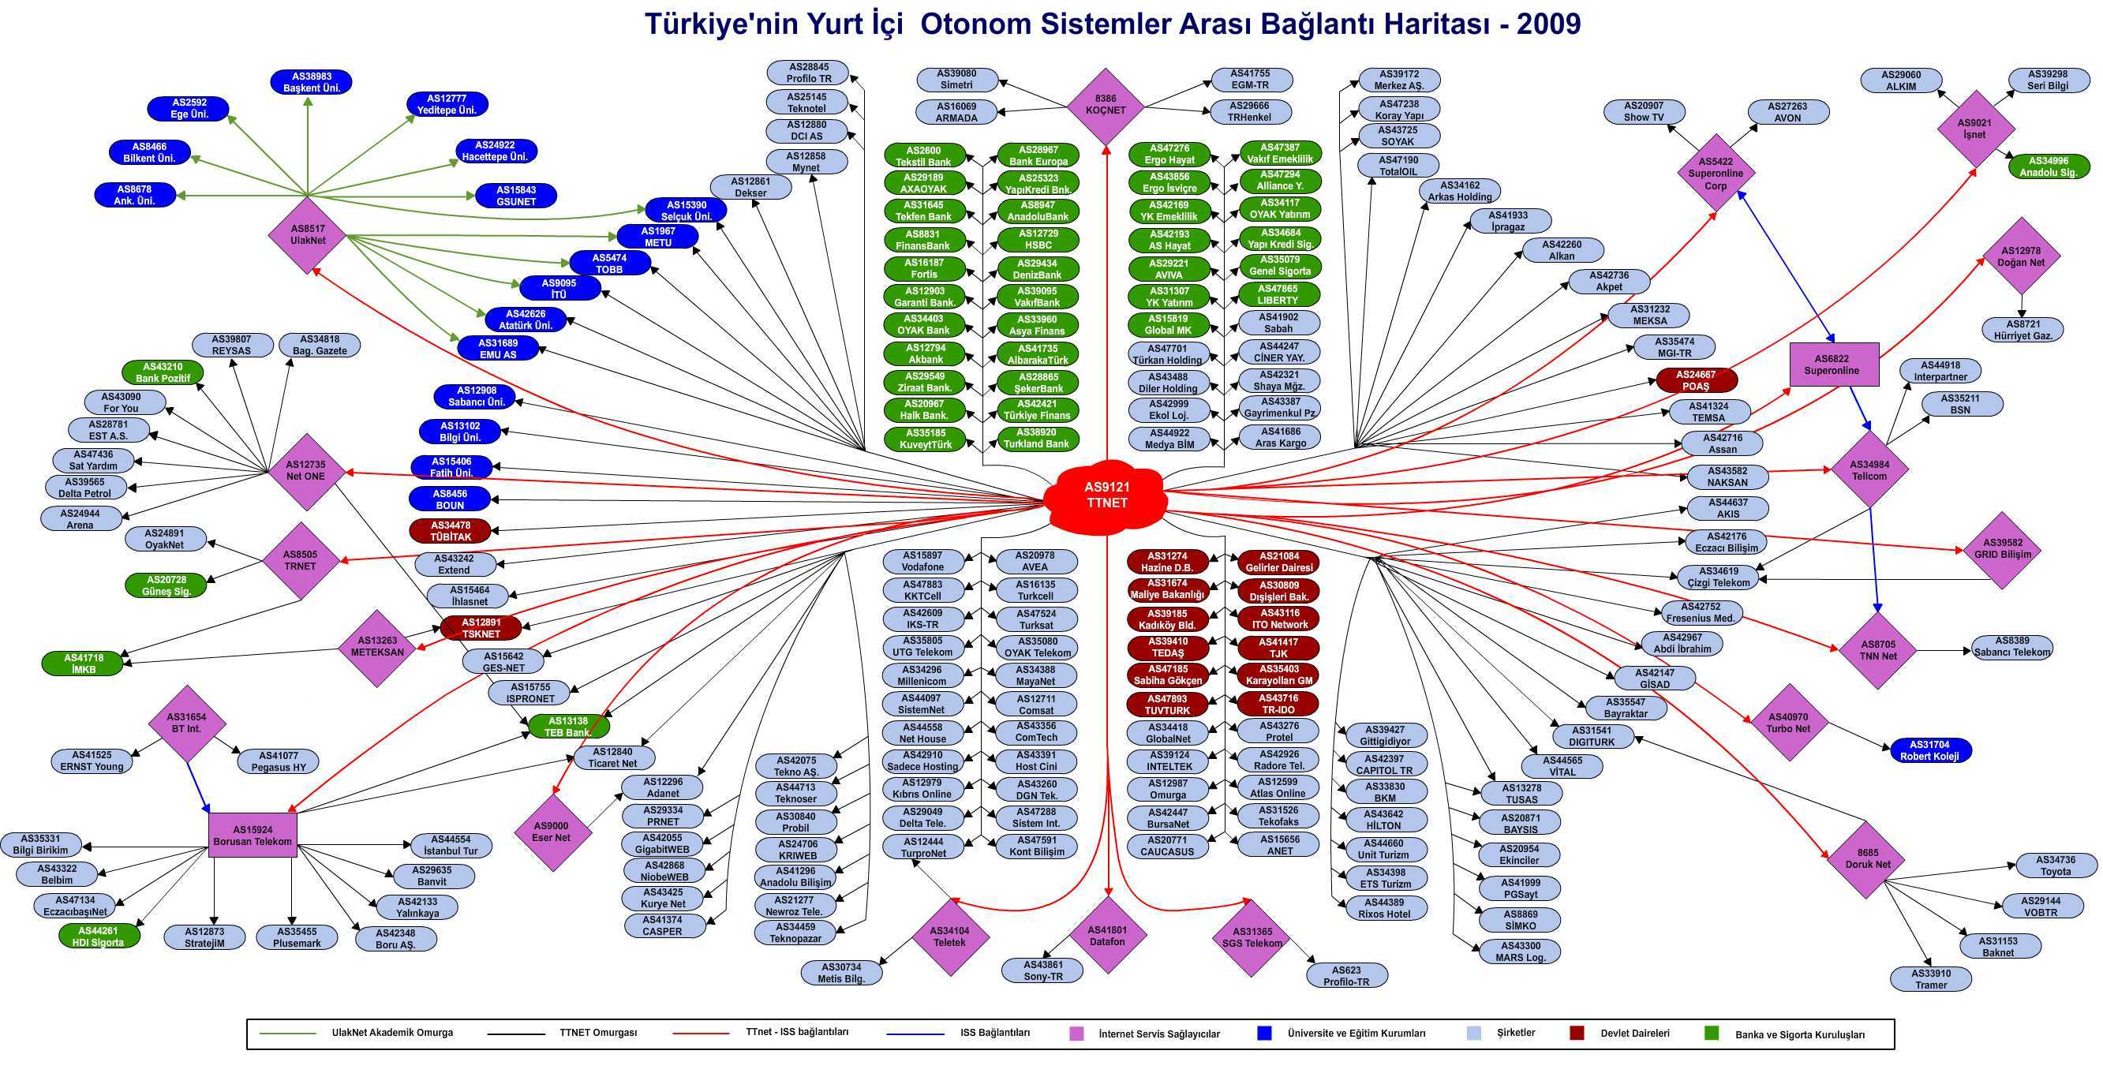
Example

Slide 24
Intra-AS Routing
Also known as Interior Gateway Protocols (IGP)
Most common Intra-AS routing protocols:
RIP: Routing Information Protocol: Distance Vector
OSPF: Open Shortest Path First: Link State
IGRP: Interior Gateway Routing Protocol (Cisco proprietary)
IS-IS: Intermediate System to Intermediate System: Link State

Slide 25
OSPF (Open Shortest Path First)
“open”: publicly available
uses Link State algorithm
LS packet dissemination
topology map at each node
route computation using Dijkstra’s algorithm
advertisements disseminated to entire AS (via flooding)
carried in OSPF messages directly over IP (rather than TCP or UDP

Slide 26
OSPF “advanced” features (not in RIP)
security: all OSPF messages authenticated (to prevent malicious intrusion)
multiple same-cost paths allowed (only one path in RIP)
For each link, multiple cost metrics for different TOS (e.g., satellite link cost set “low” for best effort; high for real time)
hierarchical OSPF in large domains.

Slide 27
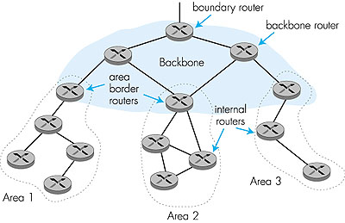
Hierarchical OSPF
connect to other AS’s
backbone
run OSPF routing
limited to backbone.
summarize” distances to nets in own area, advertise to other Area Border routers.
local area
Link-state advertisements only in area
each nodes has detailed area topology; only know direction (shortest path) to nets in other areas.
two-level hierarchy

Slide 28
Internet AS Hierarchy

Slide 29
Inter-AS tasks
AS1 must:
learn which destinations are reachable through AS2 and AS3
propagate this reachability info to all routers in AS1
Job of inter-AS routing!
How does router 1d in AS1 install routing table entry for some far away subnet x:
router should forward packet to gateway router, but which one?
x
3c
3a
2c
3b
2a
AS3
2b
1c
AS2
1a
1b
1d
AS1

Slide 30
Example: Setting forwarding table in router 1d
suppose AS1 learns (via inter-AS protocol) that subnet x is reachable via AS3 (gateway 1c) but not via AS2.
inter-AS protocol propagates reachability info to all internal routers in AS1:
For all AS1 routers: if you want to forward a packet to subnet x send it to router 1c
…
x
3c
3a
2c
3b
2a
AS3
2b
1c
AS2
1a
K
1b
AS1
1d

Slide 31
Example: Setting forwarding table in router 1d
For all AS1 routers: if you want to forward a packet to subnet x send it to router 1c
router 1d determines from intra-AS routing info that its interface K is on the least cost path to 1c.
installs forwarding table entry (x,K)
…
x
3c
3a
2c
3b
2a
AS3
2b
1c
AS2
1a
K
1b
AS1
1d

Slide 32
Example: Choosing among multiple ASes
now suppose AS1 learns from inter-AS protocol that subnet x is reachable from AS3 and from AS2.
to configure forwarding table, router 1d must determine towards which gateway it should forward packets for dest x.
install forwarding table entry (x,K) or (x,P) in 1d?
this is also job of inter-AS routing protocol!
…
…
x
3c
3a
2c
3b
2a
AS3
2b
1c
AS2
1a
K
1b
1d
P
AS1

Slide 33
Example: Choosing among multiple ASes
Hot potato routing:
send packet towards the closest of two border routers.
hands off traffic to a downstream ISP as quickly as it can.
the goal is to get rid of traffic as soon as possible so as to minimize the amount of work that the ISP's network needs to do.
Cold-potato routing:
ISP carries traffic as far as possible on its own network before handing it off to a downstream ISP.
the goal is carry traffic on the ISP's network as long as possible to maximize the control that the ISP has on the end-to-end quality of service.
In general, an ISP's routing policy would lie somewhere in between the extremes of hot-potato and cold-potato routing.

Slide 34
Internet inter-AS routing: BGP
BGP (Border Gateway Protocol): the de facto standard
BGP provides each AS a means to:
Obtain subnet reachability information from neighboring ASs.
Propagate reachability information to all AS-internal routers.
Determine “good” routes to subnets based on reachability information and policy.
allows subnet to advertise its existence to rest of Internet: “I am here”

Slide 35
Remember: Hierarchical addressing
Organization 0
BGP advertisements
200.23.16.0/23
“Send me anything
with addresses
beginning
200.23.16.0/20”
Organization 2
200.23.20.0/23
.
ISP A
.
.
.
.
Internet
Organization 7
.
200.23.30.0/23
Organization 1
ISP B
“Send me anything
with addresses
beginning 199.31.0.0/16
or 200.23.18.0/23”
200.23.18.0/23
199.31.0.0/16

Slide 36
BGP basics
BGP sessions: pairs of routers (BGP peers) exchange routing info over semi-permanent TCP connections
need not correspond to physical links.
e(xternal) BGP session
3c
i(nternal) BGP session
2c
3a
3b
2a
AS3
2b
1c
AS2
1a
1b
AS1
1d

Slide 37
BGP sessions
external BGP (EBGP)
exchanges between different ASs
to perform inter-AS routing.
internal BGP (IBGP)
exchanges within a single AS.
to perform intra-AS routing.
e(xternal) BGP session
3c
i(nternal) BGP session
2c
3a
3b
2a
AS3
2b
1c
AS2
1a
1b
AS1
1d

Slide 38
Distributing reachability info
using eBGP session between 3a and 1c, AS3 sends prefix reachability info to AS1.
1c can then use iBGP do distribute new prefix info to all routers in AS1
1b can then re-advertise new reachability info to AS2 over 1b-to-2a eBGP session
when router learns of new prefix, it creates entry for prefix in its forwarding table.
eBGP session
3c
iBGP session
2c
3a
3b
2a
AS3
2b
1c
AS2
1a
1b
AS1
1d

Slide 39
Distributing reachability info
when AS2 advertises a prefix to AS1:
AS2 promises it will forward datagrams towards that prefix.
AS2 can aggregate prefixes in its advertisement
e(xternal) BGP session
3c
i(nternal) BGP session
2c
3a
3b
2a
AS3
2b
1c
AS2
1a
1b
AS1
1d

Slide 40
Remember: Routing Advertisements
Organization 0
200.23.16.0/23
Aggregated BGP advertisement
“Send me anything
with addresses
beginning
200.23.16.0/20”
Organization 2
200.23.20.0/23
.
ISP A
.
.
.
.
Internet
Organization 7
.
200.23.30.0/23
Organization 1
ISP B
“Send me anything
with addresses
beginning 199.31.0.0/16
or 200.23.18.0/23”
200.23.18.0/23
199.31.0.0/16

Slide 41
BGP routing policy Example
legend:
provider
B
network
X
W
A
customer
C
network:
Y
A,B,C are provider networks
X,W,Y are customer (of provider networks)
X is dual-homed: attached to two networks
X does not want to route from B to C
.. so X will not advertise to B a route to C

Slide 42
BGP routing policy (2)
legend:
provider
B
network
X
W
A
customer
C
network:
Y
A advertises path AW to B
B advertises path BAW to X
B does not advertise path BAW to C
B gets no “revenue” for routing CBAW since neither W nor C are B’s customers
B wants to force C to route to W via A
B wants to route only to/from its customers!

Slide 43
Why different Intra- and Inter-AS routing ?
Policy:
Inter-AS: admin wants control over how its traffic routed, who routes through its net.
Intra-AS: single admin, so no policy decisions needed
Scale:
hierarchical routing saves table size, reduced update traffic
Performance:
Intra-AS: can focus on performance
Inter-AS: policy may dominate over performance

Slide 44
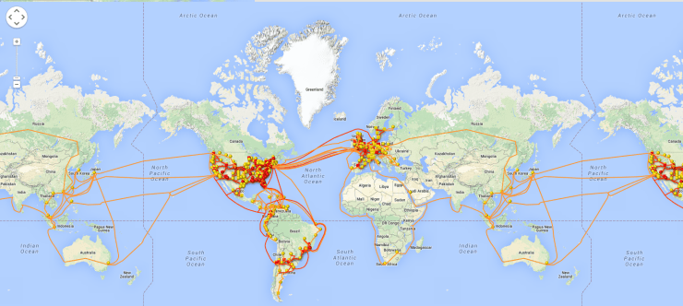
The largest AS: Level 3
http://icaruswept.com/2016/06/28/who-owns-the-internet/
AS’s customer cone: the set of ASes an AS can reach using customer links.
Level 3 Customer Cone: 30,814

Slide 45
Network Layer Part II: Routing

